Slide 1

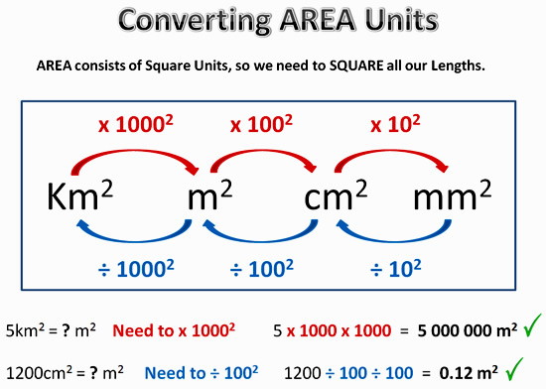
My Measurement Interactive Notebook
Name
Class
Teacher Mr Evans
Term 1 Semester 1
1

Slide 2
Contents
Glossary or Formula Page
Page
Date
Description
2
3

Slide 3
Tasks
24
7
30
Essential Question
Questions
Notes
Summary
6
7

Slide 4
24
7
30
Date
Topic : Volume of Compound Prisms
EQ – How do you find the volume of a compound prism?
What is a compound prism?
Compound prism: a 3D shape made up of more than one prism.
How do I calculate the volume of a ____________ prism?
To find the area of compound shapes, split them up into their composite shapes.
Find the area of each shape, then add them together

Slide 5
24
7
30
Date
Topic : Volume of Compound Prisms
EQ – How do you find the volume of a compound prism?
How do I calculate the volume of a ____________ prism?
To find the area of compound shapes, split them up into their composite shapes.
Find the area of each shape, then add them together

Slide 6
I Do

Slide 7
We Do

Slide 8
You Do

Slide 9
Notes Review
24, 7 ,30
Date
Title
Essential question
Notes complete
Notes complete with colour and diagrams
Questions completed
Contents page filled in
Formula page filled in

Slide 10
Homework
Review your notes and write a summary answering the essential question.

